Slide 1
Docker and Kubernetes
Tim Stanford

Slide 2
Welcome
Agenda:
What are containers?
How to build container images
How to publish images
How to run containers
Introduction to Kubernetes
Deploying applications to Kubernetes

Slide 3
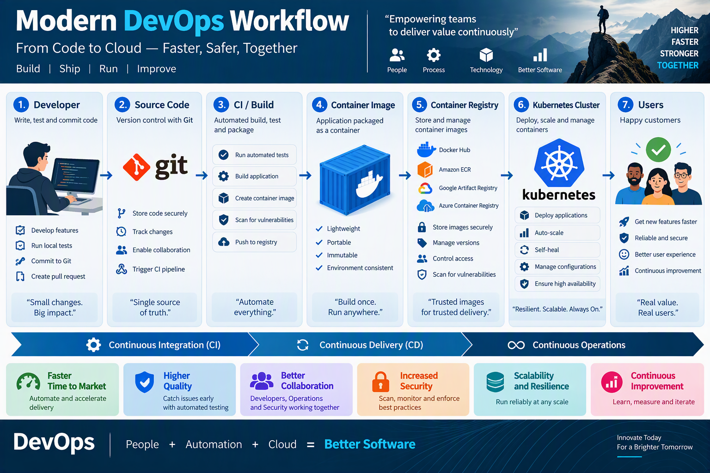

Slide 4
Containers
What are they?
  A packaged application deployment with all artifacts, dependencies and configuration
  They are run in isolation and are design for server deployments

Slide 5
How to build container images
Gather application artifacts
Create a dedicated build directory
Document prerequisites
Document installation steps
Create a Dockerfile

Slide 6
Example Application
project/
├── app.js
├── config.yml
└── Dockerfile

Slide 7
Dockerfile example
WORKDIR /usr/src/app
RUN npm install express
COPY . .
EXPOSE 3000
ENTRYPOINT ["node"]CMD ["app.js"]

Slide 8
Build the image
Use the command:
docker build -t myapp .

Slide 9
Publish a container
Optional if you are just testing on the same machine.
docker push tjstanford/myapp

Slide 10
Run a container
docker run -d -p 80:3000 --name myapp myapp
Notes:
`-d` = detached mode
`-p` = port mapping
`--name` = container name
`myapp` = image name

Slide 11
DEMO

Slide 12
Kubernetes – What is it?
A container orchestration platform
A container runtime platform
The backbone of many cloud-native deployments

Slide 13
Why Kubernetes?
Without Kubernetes:
Manual deployments
Manual scaling
Single points of failure
With Kubernetes:
Automated deployments
High availability
Automatic recovery
Horizontal scaling

Slide 14
DEMO

